Slide 1
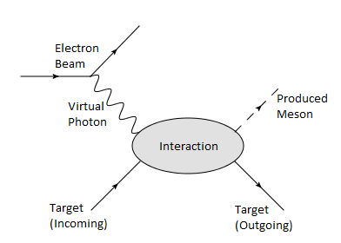
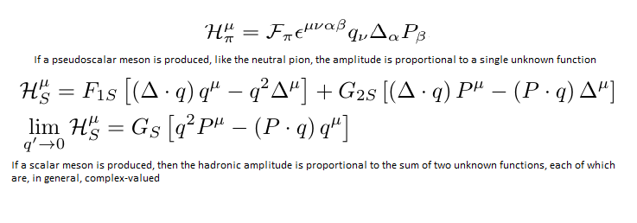

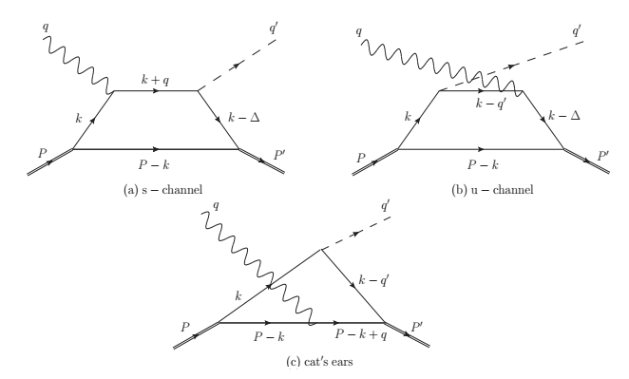
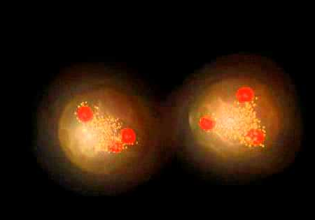

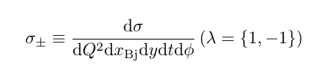
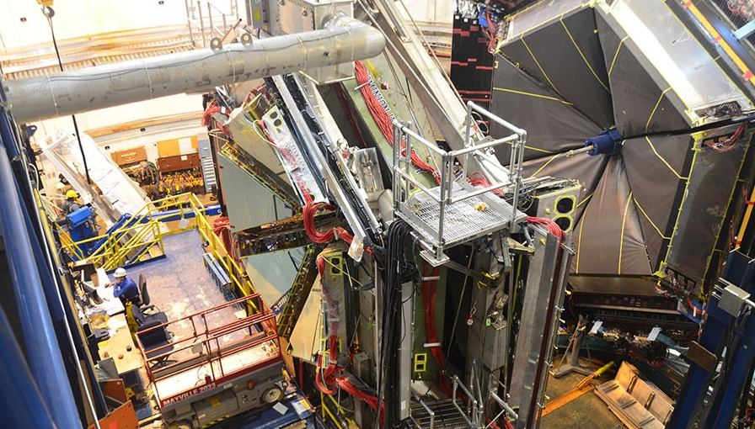
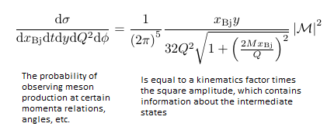
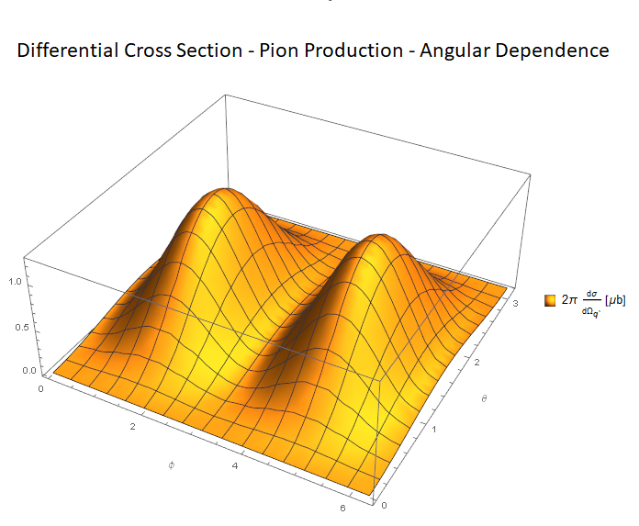
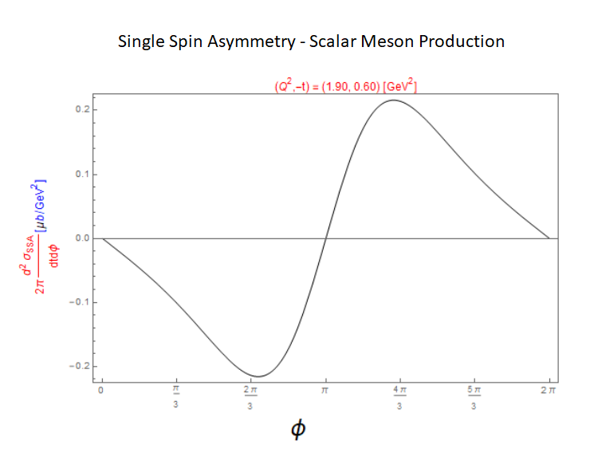
DEPARTMENT OF PHYSICS
Model-Independent Differential Cross Sections for Deeply Virtual Meson Production Processes
A. Lundeen, H. Choi, C. R. Ji
The Problem
For a target built of many constituent particles, so many types of interactions are possible that computing the amplitude is computationally intractable.
Instead, one way to tackle the problem is to use our knowledge of conserved quantities and put all our ignorance into overall functions of unknown structure, known as Form Factors
Methods of Measurement
We found a formula that extracts explicitly the angular dependence.
We also found that for pseudoscalar meson production the Single Spin Asymmetry vanishes at all angles. (The SSA is related to how the differential cross section depends on the spin polarization of the electron beam.)
Model Comparison
The box diagrams: assume the interaction is dominated by the above. We want to compute the resulting Form Factor and be ready to compare to the results from experimental measurement of the Form Factors in our model-independent method.
Background
High-energy collisions of particles can tell us about the structure of matter
Quantum field theory predicts differential cross sections and decay rates which are compared to experiment
Potential to gain keen insight into the composition and behavior of nature at its most fundamental levels
Conserved Quantities
In quantum interactions, there are conserved quantities like energy, momentum, and spin.
Special relativity says that mass and energy are two sides of the same coin
Thus, particles can be produced out of energy, provided enough energy is present.
By considering the possible intermediate states and using our knowledge of conserved quantities, we can predict the likelihood of meson production at different energies and angles; mathematically, we use the differential cross section, like the above equation.
Our Proposal
Do not make approximations and use the general expressions with the unknown Form Factors.
This is what characterizes our method as model-independent; we are advocating that this method must be used when approximations made in model-dependent methods, though insightful, begin to lose validity and therefore reach the limit of their applicability.
Measurements of differential cross sections tell us about the structure of the target through the Form Factors
This is our prediction of the differential cross section for pion production at certain angles; we have divided out the form factor, so dividing out the experimental results by this plot will give the structure of the form factor
This is our prediction of the Single Spin Asymmetry for the case of scalar meson production. We have assigned constant values to the form factors; this structure should be independent of that choice, but the overall amplitude scaling needs to be determined.
Acknowledgements:
References:
This research was funded by the Department of Energy (Grant No. DE-FG02-777 03ER41260).

